Slide 1
Transmission archetype classification

Slide 2
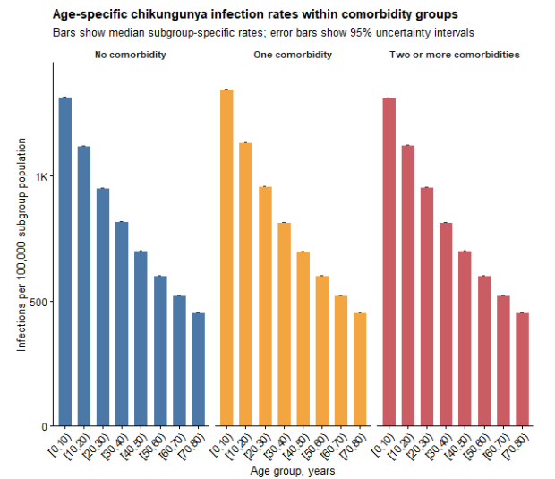
Motivation
Previous catalytic model based long-term average global burden is prone to underestimating incidence and older age burden in countries where chikungunya virus was introduced recently or outbreak is episodic
Chikungunya transmission dynamics are highly sporadic and heterogenous between countries
Transmission archetype framework
A: Finite circulation since introduction
B: Lond-term endemic equilibrium
C: Episodic transmission
D: Conditional epidemic potential (currently limited outbreak evidence)

Slide 3
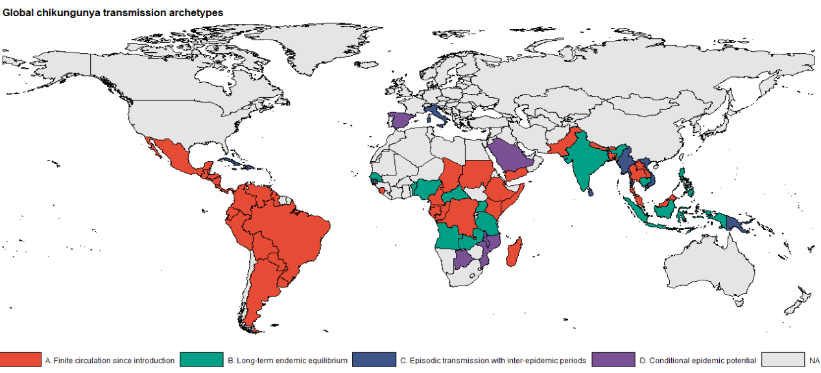
Transmission dynamic type classification
Classified 103 countries into four representative transmission types
A: Finite circulation since introduction: 39 countries
B: Lond-term endemic equilibrium: 12 countries
C: Episodic transmission: 42 countries
D: Conditional epidemic potential (currently limited outbreak evidence): 10 countries

Slide 4
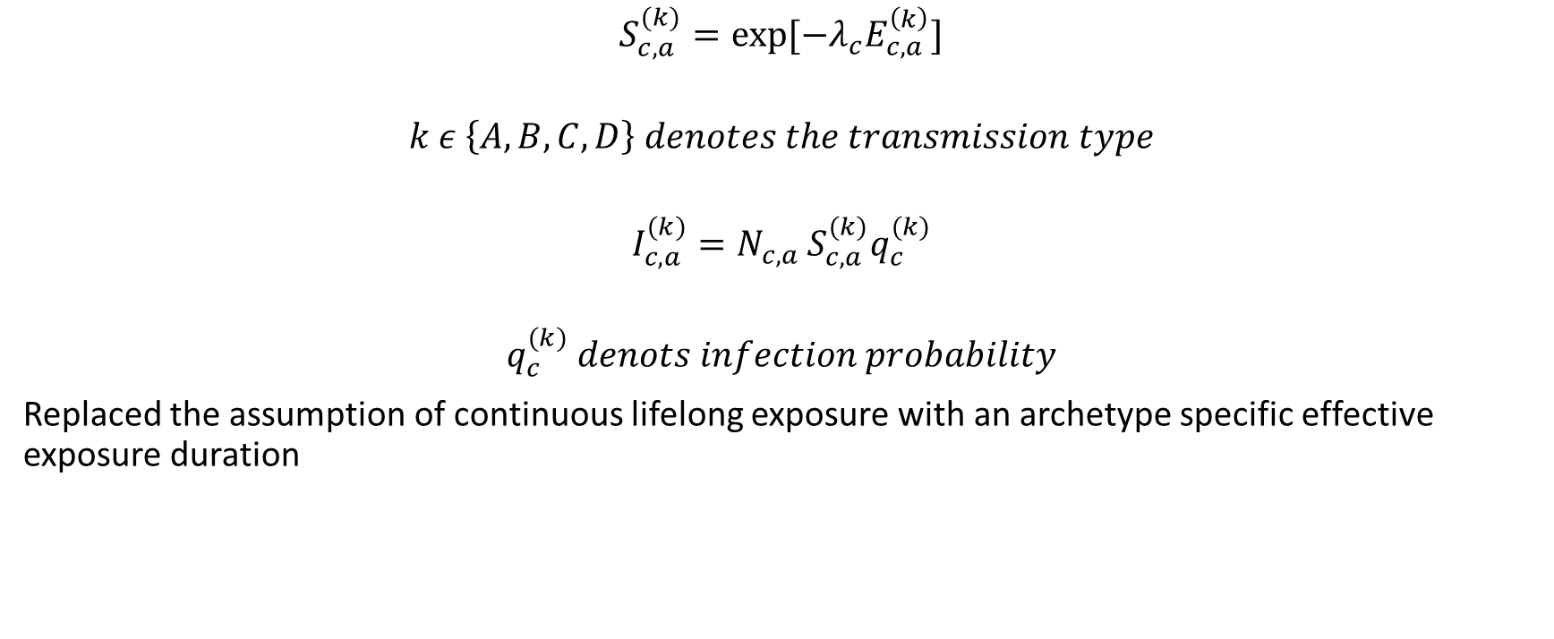
Infection model updates by transmission archetypes:
$$S_{c,a}^{(k)}=\exp{[{−λ}_{c}E_{c,a}^{\left(k\right)}]}$$
$$k ε \left\{A,B,C,D\right\} denotes the transmission type$$
$$I_{c,a}^{(k)}=N_{c,a }S_{c,a}^{(k)}q_{c}^{(k)}$$
$$q_{c}^{(k)} denots infection probability$$
Replaced the assumption of continuous lifelong exposure with an archetype specific effective exposure duration

Slide 5
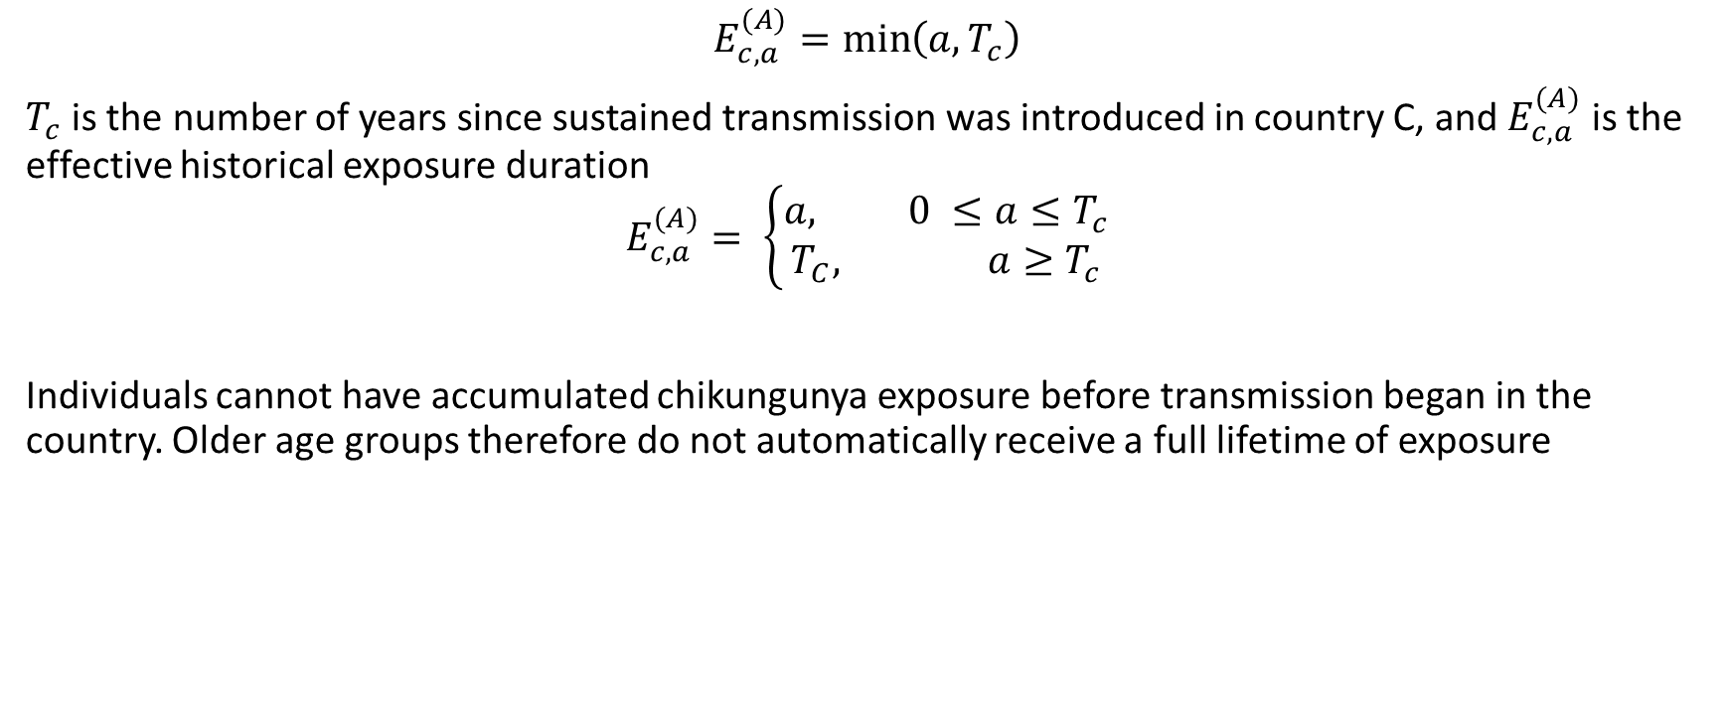
(A) Finite circulation since introduction
$$E_{c,a}^{(A)}=\min\left(a, T_{c}\right)$$
$T_{c}$is the number of years since sustained transmission was introduced in country C, and $E_{c,a}^{(A)}$ is the effective historical exposure duration
$$E_{c,a}^{(A)}= \left\{\begin{aligned}a, 0 ≤a≤T_{c} \\ T_{C}, a≥T_{c}\end{aligned}\right.$$
Individuals cannot have accumulated chikungunya exposure before transmission began in the country. Older age groups therefore do not automatically receive a full lifetime of exposure

Slide 6
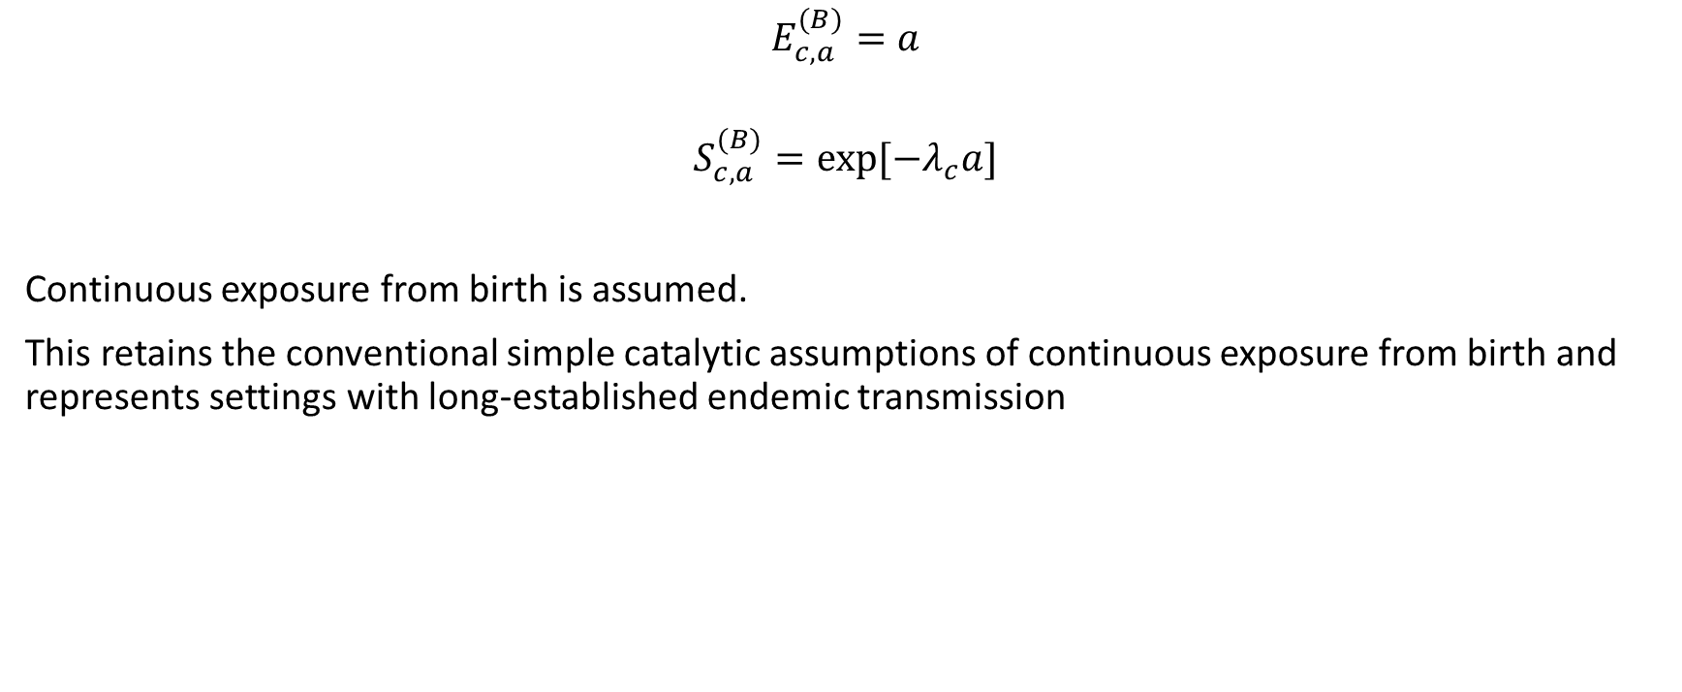
(B) Long-term endemic equilibrium
$$E_{c,a}^{(B)}=a$$
$$S_{c,a}^{(B)}=\exp{[{−λ}_{c}a]}$$
Continuous exposure from birth is assumed.
This retains the conventional simple catalytic assumptions of continuous exposure from birth and represents settings with long-established endemic transmission

Slide 7
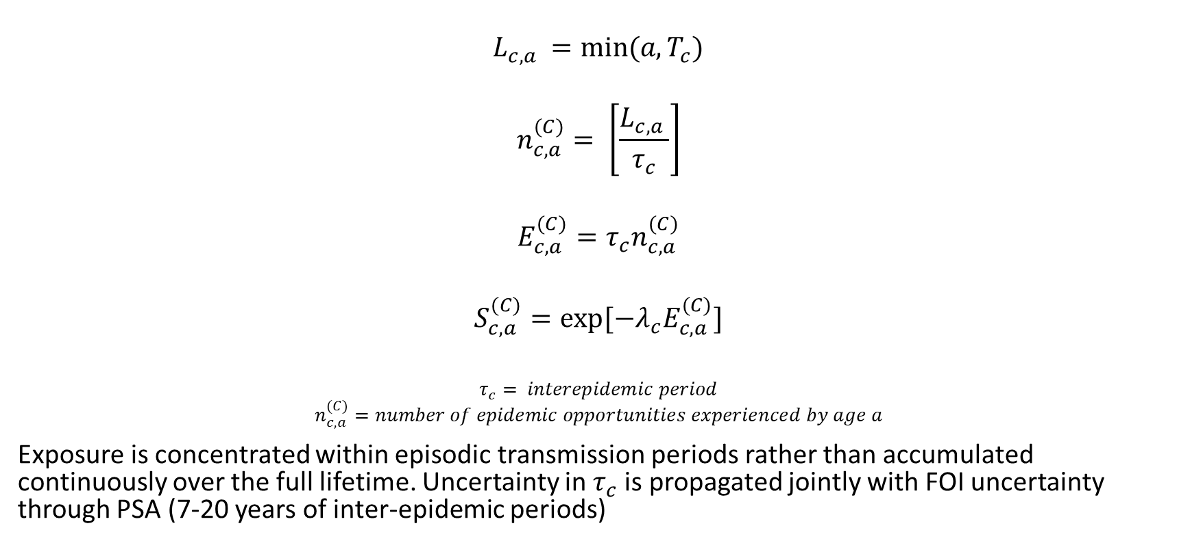
(C) Episodic transmission
$$L_{c,a }=min⁡(a, T_{c})$$
$$n_{c,a}^{(C)}= \left[\frac{L_{c,a }}{τ_{c}}\right]$$
$$E_{c,a}^{(C)}=τ_{c}n_{c,a}^{(C)}$$
$$S_{c,a}^{(C)}=\exp{[{−λ}_{c}E_{c,a}^{(C)}]}$$
$$τ_{c}= interepidemic period$$
$$n_{c,a}^{(C)}=number of epidemic opportunities experienced by age a$$
Exposure is concentrated within episodic transmission periods rather than accumulated continuously over the full lifetime. Uncertainty in $τ_{c}$is propagated jointly with FOI uncertainty through PSA (7-20 years of inter-epidemic periods)

Slide 8

(D) Conditional epidemic potential
$$I_{c,a}^{(D)}=E\left[I_{c,a }\right| O_{c}=1],$$
$$S_{c,a}^{(D)}=1$$
$$O_{c} indicates that local transmission or an outbreak occurs$$
Archetype D represents the potential burden conditional on transmission occurring.

Slide 9
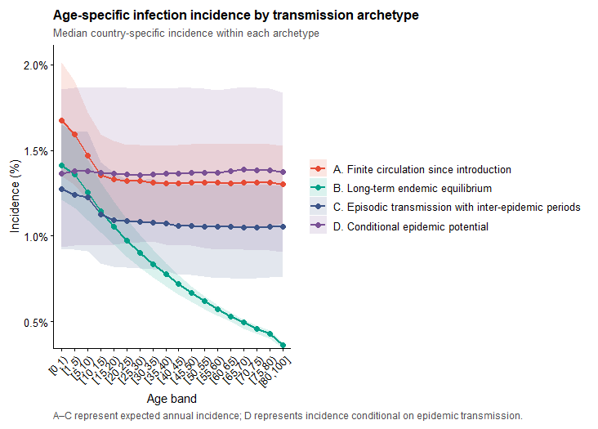
Age specific annual incidence by transmission type

Slide 10
Comorbidity analysis (underlying conditions)

Slide 11
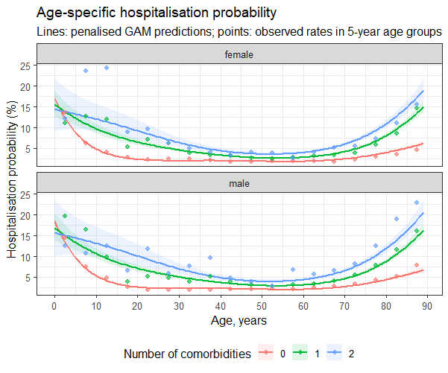
Estimating relative risk of hospitalisation using Brazil surveillance data
Fitted GAM to the observed surveillance data of confirmed and hospitalised chikungunya patients from 2017-2024
Reference group: no comorbidity

Slide 12
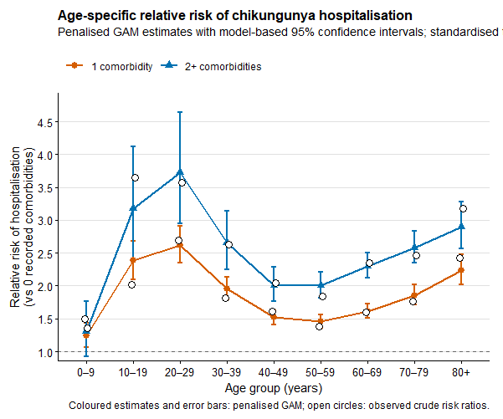
Estimating age group specific relative risk by comorbidity group using GAM
Estimated standardised risk of hospitalisation = average of predicted risk across both female and male
RR = (standardised hospitalisation risk by each comorbid group) / (reference group risk)

Slide 13
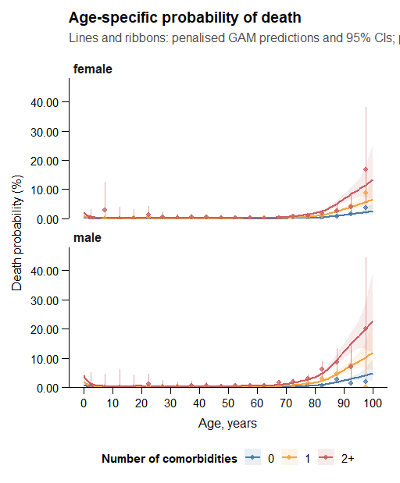
Estimating relative risk of death using Brazil surveillance data
Fitted GAM to the observed surveillance data of confirmed and hospitalised chikungunya patients from 2017-2024
Reference group: no comorbidity

Slide 14
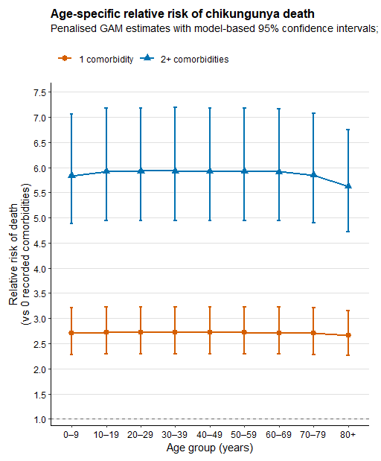
Estimating age group specific relative risk by comorbidity group using GAM
Estimated standardised risk of death = average of predicted risk across both female and male
RR = (standardised death risk by each comorbid group) / (reference group risk)

Slide 15
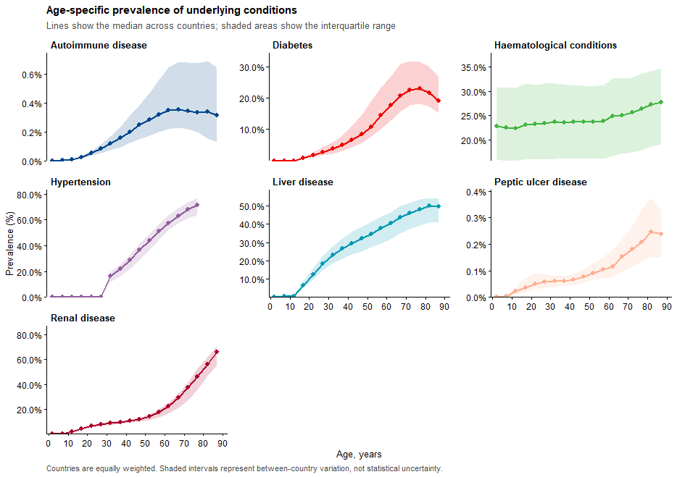
Global prevalence of underlying conditions by age group
Summary of 7 underlying conditions by age group at global, regional, and national levels (aligning with the conditions present in SINAN Brazil data)

Slide 16
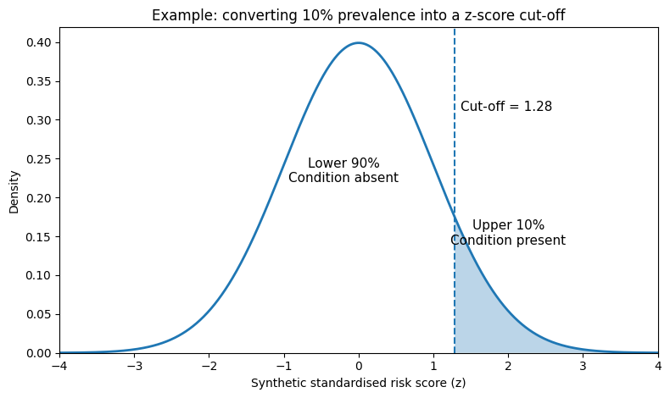

From global disease prevalence to individual disease status
$$Z=\left(Z_{i,1}, …., Z_{i,7}\right) \sim N(0, R_{a})$$
Assigning standardised risk scores
For each country and age group, create 10,000 synthetic individuals
Each individual receives one standardised risk score for each of the 7 conditions
Score 0 = an average underlying propensity
Score > 0 = higher than average propensity
Score < 0 = lower than average propensity
Condition | Prevalence | Score cut-off | Population classified positive
Diabetes | 10% | 1.28 | Highest 10%
Hypertension | 30% | 0.52 | Highest 30%
Renal disease | 5% | 1.64 | Highest 5%

Slide 17
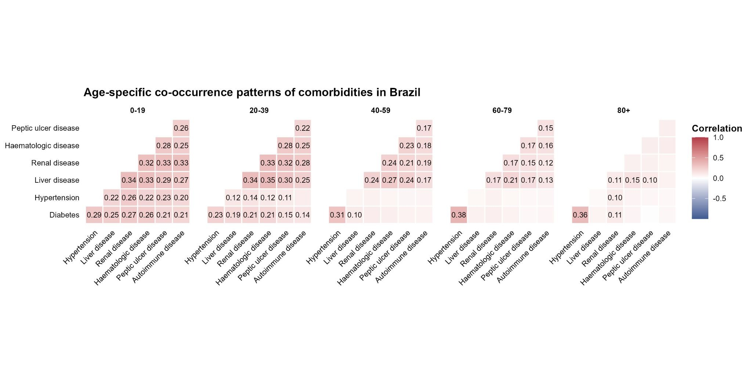
Correlation matrix by age group (7 underlying conditions)

Slide 18
Counting conditions within the synthetic population
Creating individual comorbidity profiles
Each individual receives a binary status for all 7 conditions
1 = condition present
0 = condition absent
Synthetic individual | Diabetes | Hypertension | Renal disease | Liver disease | Other conditions | Total conditions
Person 1 | 0 | 0 | 0 | 0 | 0 | 0
Person 2 | 0 | 1 | 0 | 0 | 0 | 1
Person 3 | 1 | 1 | 0 | 0 | 0 | 2
Person 4 | 0 | 1 | 1 | 1 | 0 | 3
Person 5 | 1 | 0 | 0 | 0 | 0 | 1
Final mutually exclusive groups by number of conditions

Slide 19
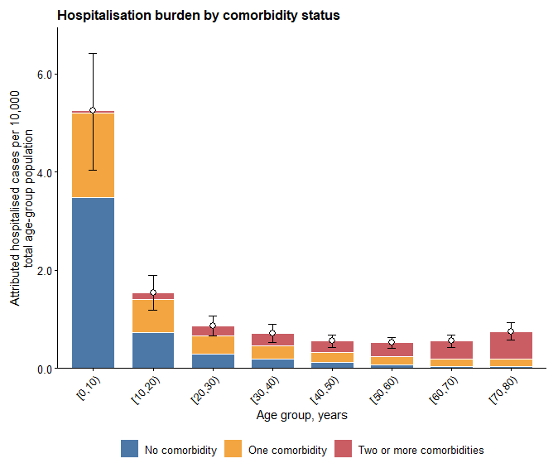
Probability of hospitalisation by number of underlying conditions (0, 1, 2 +)

Slide 20
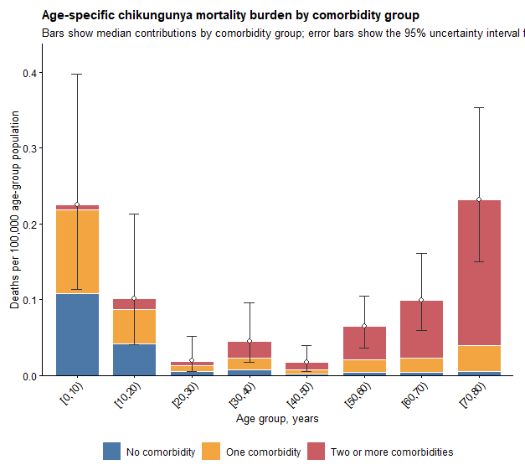
Global average age specific chikungunya deaths per 10,000 chik-confirmed individuals

Slide 21
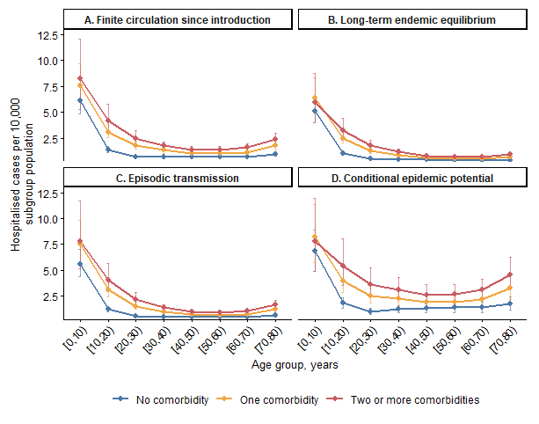
Hospitalisation per 10,000 individuals by age, comorbidity group, and transmission archetype

